Slide 1
River Valley Civilizations… the beginnings of a new era
The Tigris and Euphrates Rivers
The Nile River
The Indus River
The Yellow River

Slide 2
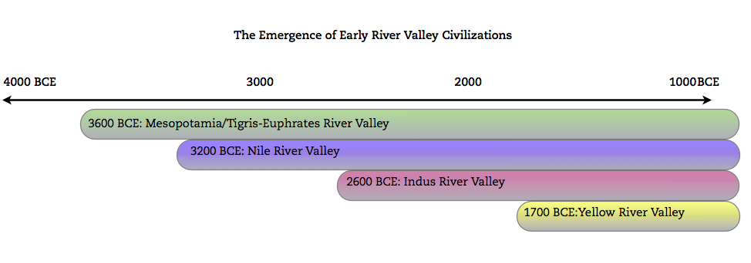
Turn and Talk:
By what time in Era 2 were all four river valley civilizations in existence?
What do you think was going on in each of these places before their civilizations developed? For example, do you think there were people living in the Indus River Valley in 3000 BCE? If so, why wasn’t it considered a civilization yet?

Slide 3
Why 4,000 BCE?
Farming, in one form or another, had been around for between 5 and 6 thousand years. So why did civilization develop in 4,000 BCE (give or take a couple of centuries!)?
How does this feedback loop help answer the question above?

Slide 4
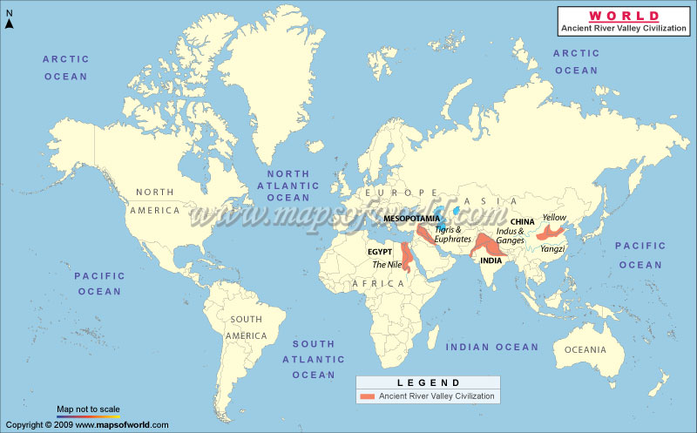
Flashback… What do you notice about the latitude of these civilizations? Why does this matter?

Slide 5
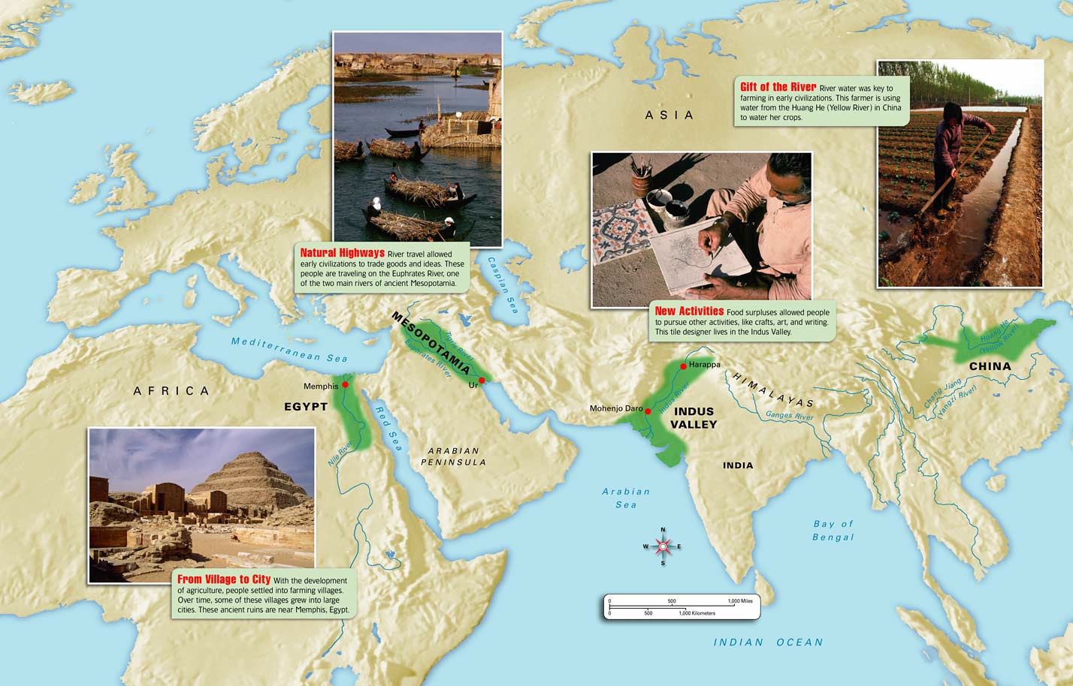
Stop and Jot- Why rivers? Why these rivers in particular?
Notes:
http://www.mrsk.net/wh06as_c03map004aa.jpg

Slide 6
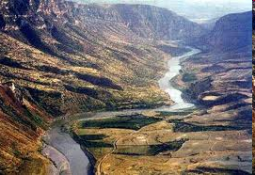
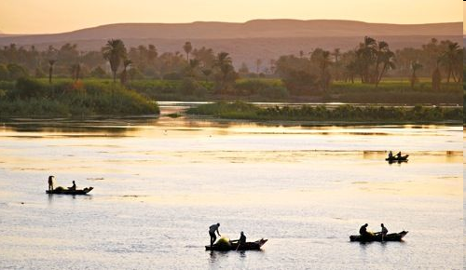
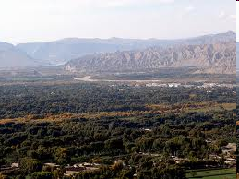
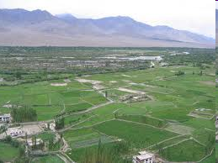
Tigris River
Nile River
Indus River
Yellow River
Study these modern photographs of the four river valleys. List the similarities you see. Turn and Talk: Why do the similarities matter? Why rivers and not lakes? What’s special about rivers?

Slide 7
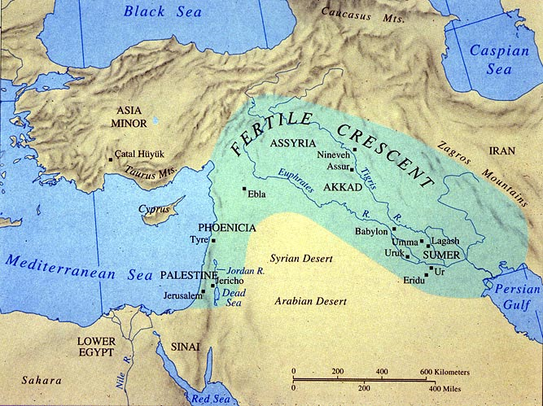
Map Skills – Find the Mediterranean, Black, and Caspian Seas on the map of the Fertile Crescent. Now find them on the larger map of the world.

Slide 8
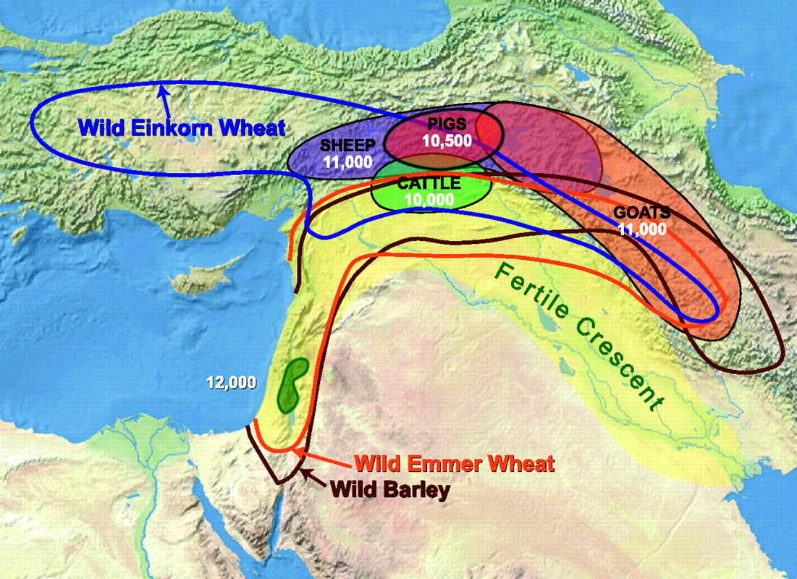
Crops and Animal Domestication in the Fertile Crescent
Driscoll C A et al. PNAS 2009;106:9971-9978
©2009 by National Academy of Sciences
Notes:
Map of the Near East indicating the Fertile Crescent (according to ref. 23). Shaded areas indicate the approximate areas of domestication of pig, cattle, sheep, and goats with dates of initial domestication in calibrated years B.P. (after ref. 3). Colored lines enclose the wild ranges of Einkorn wheat, emmer wheat, and barley (after ref. 21). Green-shaded area in southern Levant indicates the region where all 3 grains were first domesticated 12,000 years B.P.

Slide 9
From <http://www.utexas.edu/courses/classicalarch/images2/mapane.jpg>
Find Catal Huyuk and Jericho, two sites you studied earlier, on this map. Which one is in the Fertile Crescent? Have you heard of any of the other cities on this map?

Slide 10
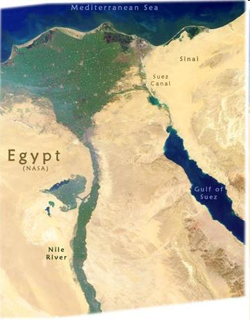
Turn and Talk:
What kind of picture do you think this is?
What clues can you use?
What does it show?
What do you think the green and yellow areas are?
Where do you think most people live in this area?
What is a delta?
Why are deltas important?

Slide 11
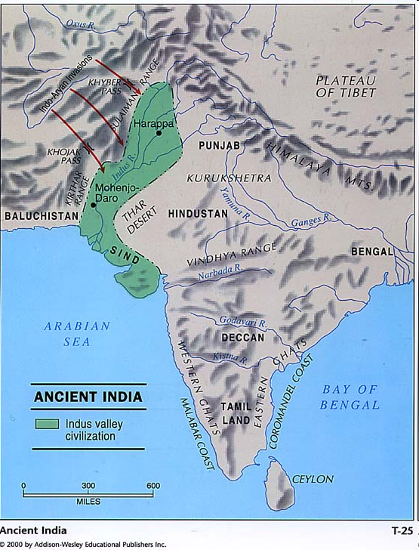
Stop and Jot:
Which civilization is shown on this map?
How do you know?
Turn and Talk:
What geographic features might have prevented this river valley from spreading northwest?
How about to the southeast?
http://www.public.iastate.edu/~cfford/342worldhistoryearly.html

Slide 12
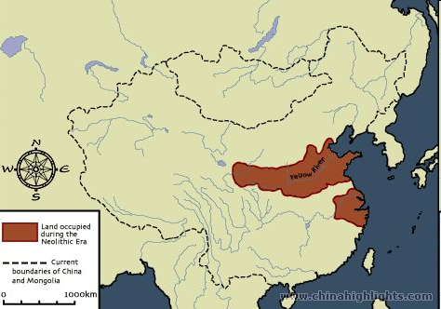
What civilization was in the highlighted area on this map?
What modern country developed out of this civilization over centuries?
Look at all the rivers in the middle. Why do you think civilization didn’t develop along one of these rivers? Turn and Talk and make your best guess.

Slide 13
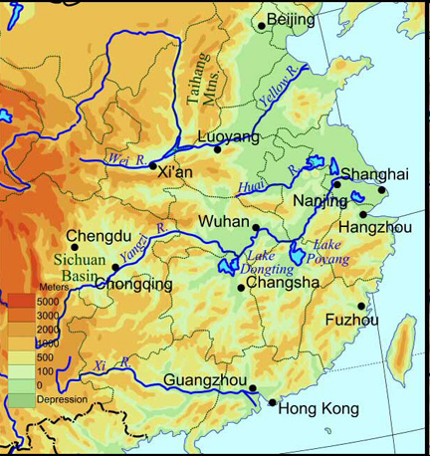
Find the Yellow River on this map.
What do the different colors mean on this map?
Turn and Talk- Use this information to modify your answer to the question: Why did civilization develop along the Yellow River and not some of the others?
http://depts.washington.edu/chinaciv/geo/proper.htm

Slide 14
Defining and Describing Civilization Part 2:
Below are the definitions we used in the last lesson to help us understand civilization.
You will get a handout now with an expanded description of what civilization means.
Which one of the definitions below is closest to what is described on your handout?
The term “civilization” is used to describe larger groups of people living together in one place in more complex societies with social hierarchies and specialization of labor. During this era, between 4000 and 1000 BCE, this new way of living began to develop in different parts of the world.
A type of society characterized by all or most of the following features: dense population, agricultural economy, cities, complex social hierarchy, complex occupational specialization, centralized state, monumental building, a writing system, and a dominant belief system
Notes:
http://worldhistoryforusall.sdsu.edu/shared/glossary.htm

Slide 15
Characteristics of Civilizations | What this looked like in river valley civilizations:
Cities | Cities supported large populations of over 30,000 people
Specialization | Some people living in cities took full-time specialized jobs (artisan, merchant, soldier, priest) because they were supported by farmers from the surrounding community.
Hierarchy | A class system emerged where certain men (and sometimes women) held all the power. They were called elites. Men began to dominate in politics and women became more responsible for the life at home. This system is called patriarchy.
The State | One city usually ruled over all others in a civilization. A king or pharaoh with a small group of officials controlled the rest of society.
Networks of Trade | Many civilizations traded within and outside of their borders. Technology, food, and language spread from Mesopotamia outward to Egypt, India, and China.
Technology | Technology changed much more rapidly than in Era I. People developed metals like bronze and use those build things like wheeled carriages.
Monuments | Large buildings were constructed like city walls, temples, palaces, and tombs for powerful rulers.
Spiritual Beliefs and Laws | Spiritual beliefs and laws became richer and more complex.
Creativity | Individuals worked with the ruling class to study astronomy, mathematics, sciences, and engineering.

Slide 16
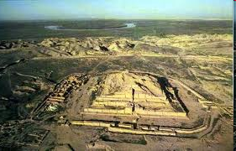
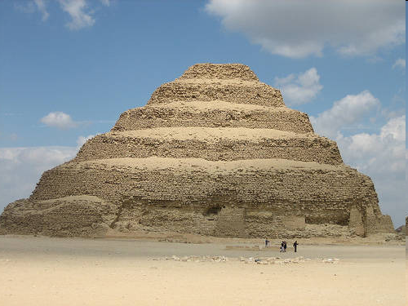
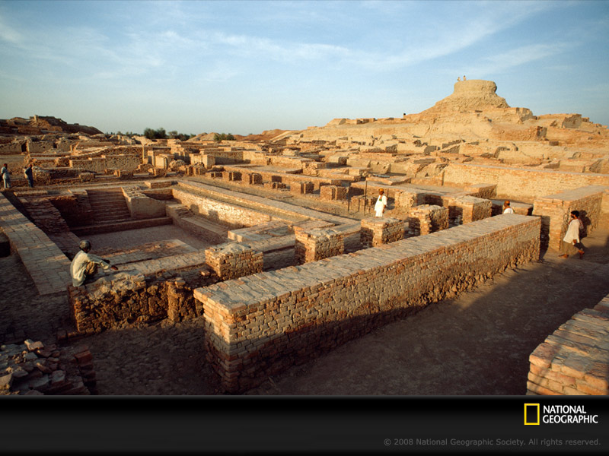
Sumer, in Mesopotamia, Tigris and Euphrates
Ancient Egypt, Nile River
Mohenjo Daro, Indus River
Yellow River, current day China

Slide 17
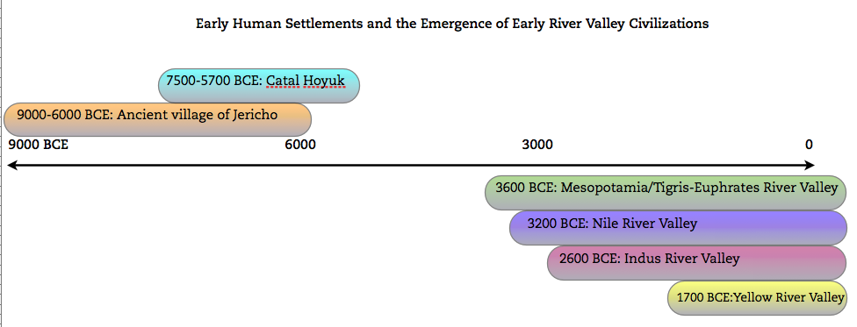
Turn and Talk: What do you notice about this revised timeline?
How long did it take, for example, for civilization to develop in the Tigris/Euphrates valley after villages like Jericho emerged?

Slide 18
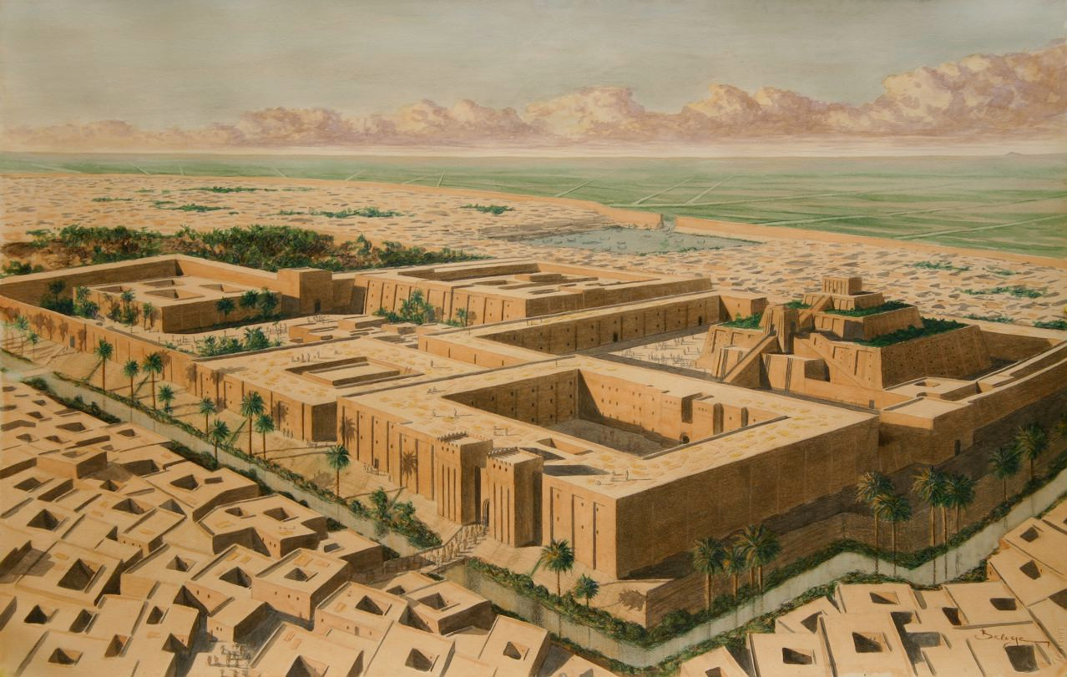
Cities
Specialization
Hierarchy
The State
Networks of Trade
Technology
Monuments
Spiritual Beliefs and Laws
Creativity
The city of Ur, Sumer (Mesopotamia)
Study the artist’s rendering of Ur (a city in Sumer) above.
What evidence do you see for any of the characteristics of civilizations?

Slide 19
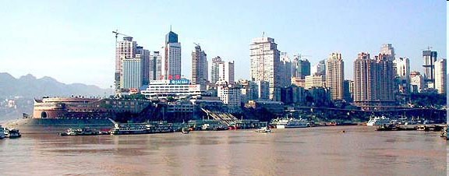
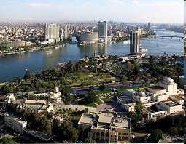
BTW…. People still live near these rivers… the cities have gotten a little bigger though!
Chongqing, Sichuan, China
on the Yellow River
Cairo, Egypt… on the Nile River

Slide 20
Property of Oakland Schools
Authors: Stacie Woodward and Darin Stockdill
Editors: Amy Bloom and Kimberly Hase Galek

