Slide 1
Guns, Germs & Steel
A geographical look at history – inspired by Jared Diamond

Slide 2
Key Vocabulary
Geography – the study of the earth’s land and people
Latitude – lines that measure from North to South, often leading to changes in climate (e.g. the Equator)
Longitude – lines that measure from East to West, leading to changes in time zones (e.g. the Prime Meridian)
Nomad – people who wander from place to place, following their food; hunter-gatherers
Domesticate – training plants and/or animals for human use
Sedentary – settled; staying in one place
Specialization – developing special skills or training

Slide 3
Key Question:
To what extent (how much) has history been shaped by geography?

Slide 4
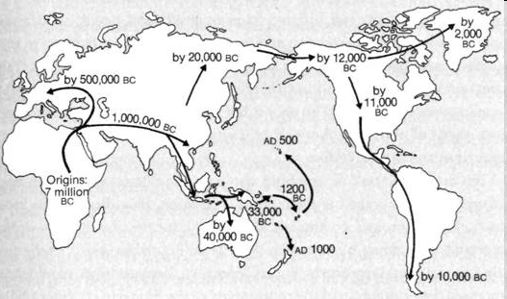
Jared Diamond’s book: Guns, Germs & Steel
Diamond says that geography has led different civilizations to develop at different rates.
The earliest people came from Eastern Africa and were nomads.
They spread across the world over time, stopping when and where they found food.

Slide 5
Geographic Luck:
Diamond’s describes how ‘geographic luck’ allowed people to develop civilizations:
First they needed to domesticate plants and animals.
This gave them a reliable source of food and allowed them to create sedentary societies.
When they were able to grow surplus (extra) food this led to specialization, as some people developed crafts and trade rather than farming.
Specialization allowed them to develop increasingly complex technology, including writing systems and a form of government.

Slide 6
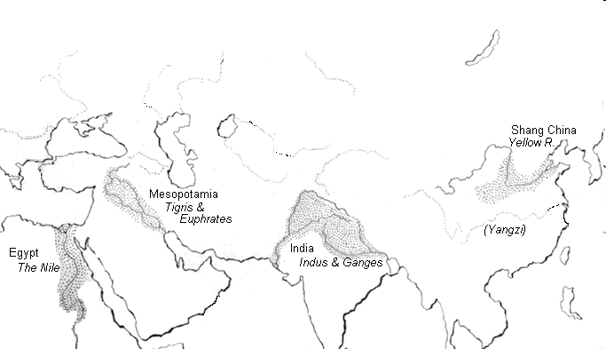
River Civilizations
‘Geographic luck’ sometimes began with a river, which provided a steady source of food and water.
Many of the earliest civilizations developed around rivers:
Ancient Egypt depended on the Nile River
Ancient Mesopotamia was in an area called ‘The Fertile Crescent’ between the Tigris & Euphrates Rivers
Ancient India developed between the Indus and Ganges Rivers.
Ancient China developed along the Yangzi and Huang He (Yellow) Rivers.

Slide 7
Food:
Plants and animals were the key to ‘geographic luck’.
Some plants and animals could be domesticated easily, providing large numbers of people with a reliable source of food.
Plants in Europe, Asia & North Africa included rice, wheat, and barley.
Animals included pigs, cows, sheep and horses. These could be used for food and also to help people with work.
This allowed Asians and Europeans to develop sedentary society early and eventually led to large civilizations.
Other plants and animals were not easily domesticated, so people remained nomads (following their food).
Most of the plants and animals in the Americas and Sub-Saharan Africa were wild, so they were not a reliable source of food or work.
As a result, people in Southern Africa and the Americas remained nomads for thousands of years.

Slide 8
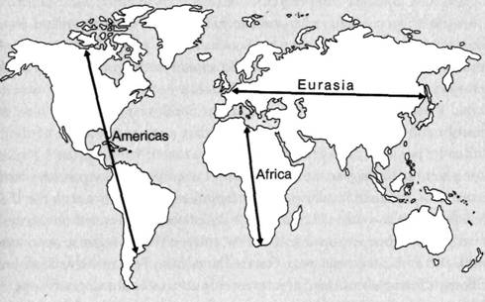
Latitude and Longitude
The shape of the continents was also important.
Europe and Asia share similar latitudes, so the climate does not change much across the continents, and civilizations can easily spread with their plants, animals and technology.
Africa and the Americas have similar longitude, but very different latitudes. As the latitude changes, so does the climate, making it very difficult to share ideas about food and farming.
As a result, large civilizations helped to conquer and spread technologies across Europe and Asia, while Africa and America remained less developed.

Slide 9
Population
As large civilizations developed in Europe and Asia, populations grew.
These populations often shared cities and food sources, and were exposed to more diseases.
So people developed resistance to germs.
They also developed advanced technologies, like ships and navigation tools that allowed them to sail across oceans exploring the world.
Finally, they fought with one-another, so they developed deadly weapons, including guns and steel swords.

Slide 10
Conquest
In the 1400-1500s, Europeans set out with their new tools to conquer the world.
They sailed to Africa and America and used their guns, germs, and steel to take over:
Riding horses and armed with guns and germs (like small pox), they enslaved and killed many Africans and Americans and took over much of their land.
They said their conquest showed that white people were smarter, but Jared Diamond says it was because they had better ‘geographic luck’.
What do you think?

Slide 11
How did people transition from nomadic tribes to settled communities?
Create a flow chart of key stages in this development from your Guns, Germs and Steel notes.
Hunter-Gatherers

