Slide 1

Big Era Four
Expanding Networks
of Exchange and Encounter
1200 BCE – 500 CE

Slide 2


Welcome to Big Era Four!

Slide 3
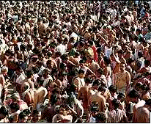
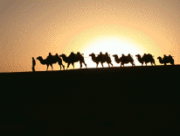
Let’s focus on two key developments of this era.
Population Growth
Expanding Networks of Exchange

Slide 4

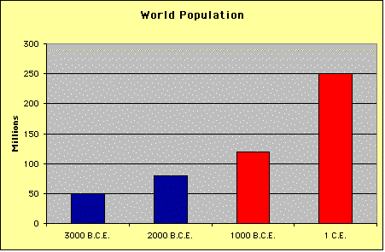
Population Growth
• Between 1000 BCE and 1 CE world population rose from about 120 to about 250 million.
• This rise was fueled by an acceleration in the rate of growth during this time.
• Between 3,000 and 1,000 BCE, it took about 1,600 years for world population to double.
• Between 1,000 BCE and 1 CE the doubling time was less than 1,000 years.

Slide 5

Population Growth
What caused this surge in population?

Slide 6
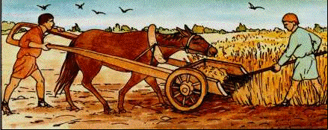
Population Growth
#1
The invention of iron!
In Afroeurasia, iron axes, hoes, spades, and plows enabled farmers to clear and cultivate millions of acres never before used for farming.

Slide 7
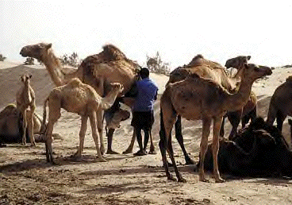
Population Growth
#2
Farming and pastoral nomadism!
Farming and pastoral nomadism replaced hunting and gathering in some regions.
People moved into previously uninhabited areas.

Slide 8
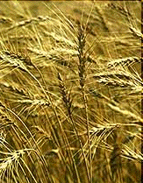

Population Growth
#3
Improved species of crops produced more food per acre!

Slide 9

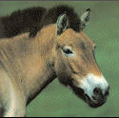
Population Growth
#4
Horses and camels were used for work!
#4
Work animals made farms more productive.

Slide 10
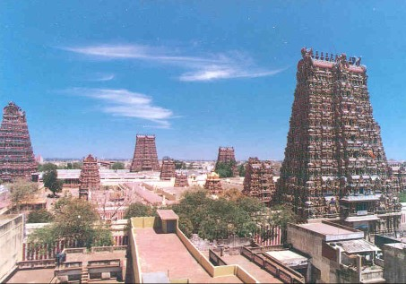
Population Growth
It was connected to the build-up of natural immunities to local infectious diseases.
#5
People now lived in denser populations!

Slide 11
Population Growth
In Summary:
In Afroeurasia, the invention of iron enabled farmers to clear and cultivate millions of acres never before used for farming.
Farming and pastoral nomadism replaced hunting and gathering in some regions. People moved into previously uninhabited areas.
Improved kinds of crops produced more food per acre.
Horses and camels began to be used more as work animals, making farms more productive.
People began to live closer in denser populations. This led to the build-up of natural immunities to local infectious diseases but left people vulnerable to epidemics caused by diseases new to the region.

Slide 12
What were the consequences of population growth?
Population Growth
Consequences

Slide 13
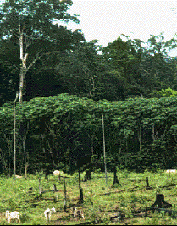
Population Growth
Consequences
Over time, the clearing of forests led to soil erosion, shortages of wood for fuel, and the extinction of some local animal and plant species.
#1
Deforestation!

Slide 14
Population Growth
Consequences
#2
More complex societies!
As populations grew and communities grew larger, more complex, and closer together, organization became more important. New political, social, and economic systems emerged.
The Indian Caste System

Slide 15
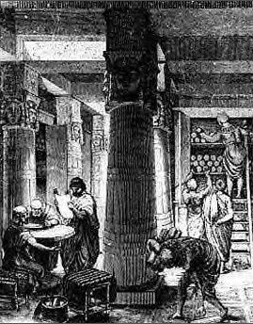
Population Growth
Consequences
#3
Collective learning increased!

Slide 16
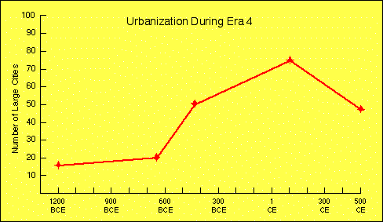
Population Growth
Cities
#4
More people began living in large cities!

Slide 17
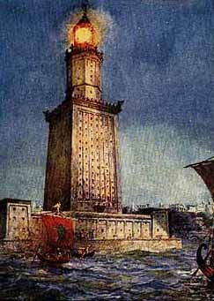
Alexandria
• Founded by Alexander the Great in 331 BCE
• Important trade center
• Its library home to many famous scholars
There were not only Greeks and Italians, but also Syrians, Libyans, Cilicians and yet others from farther countries—Ethiopians, Arabs, as well as Bactrians, Scythians, Persians, and a few Indians.
A Greek orator writing about Alexandria
The Pharos Lighthouse in Alexandria

Slide 18
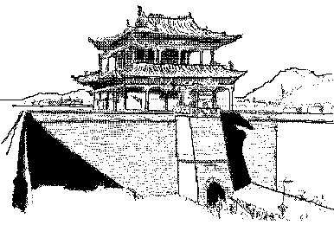
Changan (Xian)
• Capital of China during the Han dynasty
• Located at the eastern end of the silk road
• Merchants and diplomats brought trade goods and new ideas

Slide 19
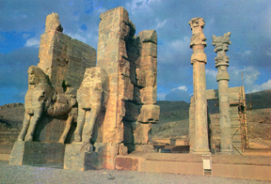
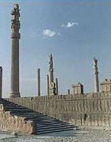
Persepolis
• Founded in the 6th century BCE by Darius I
• Capital of the Achaemenid Empire of Persia
• Destroyed by Alexander the Great in 330 BCE

Slide 20
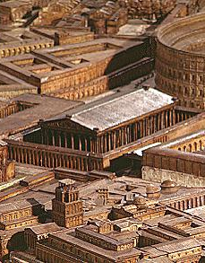
Rome
• Political and economic hub of the Roman Empire
• World’s largest city in Big Era Four, with nearly one million residents
• Elaborate water and sewer systems made Rome livable despite its size
Not without good reason did gods and men choose this spot as the site of a city.
Livy, a Roman historian

Slide 21
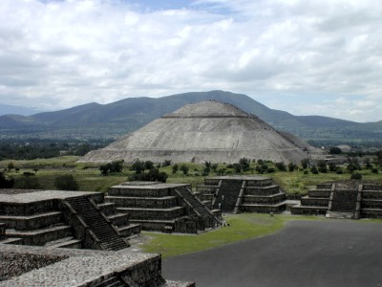
Teotihuacan
• Major city of the Americas located in the valley of Mexico
• From 400 to 600 CE, a thriving commercial and agricultural center with 200,000 residents
• The Pyramid of the Sun covered as much ground as the pyramid of Khufu in Egypt
Photo: University of Arizona
The Pyramid of the Sun, Teotihuacan

Slide 22
Population Growth
In Summary:
Over time, deforestation led to soil erosion, shortages of wood for fuel, and the extinction of some local animal and plant species.
When communities grew larger, more complex, and closer together, new political, social, and economic systems became necessary.
Collective learning increased, further fueling advances in technology.
Although the vast majority of people still inhabited rural farming villages, more people than ever before began living in large cities.

Slide 23

Expanding Networks
That’s easy! A network of exchange is a web of connections through which people, goods, and ideas circulate. Telephones, the Internet, and highways are all networks of exchange.
Hmmm... What is a network of exchange?

Slide 24
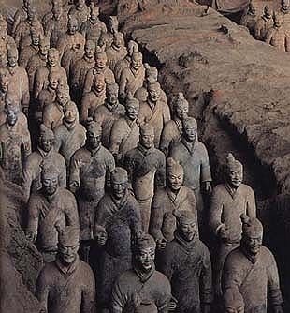
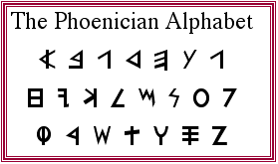

Expanding Networks
Routes Around 300 BCE to 300 CE, merchants, shippers, sea captains, and empire-builders extended and strengthened trade routes across Afroeurasia and the Americas.
Empires Empires required networks of military and political communication. These networks encouraged interaction of many kinds over long distances.
Writing With the appearance of alphabetic writing systems in Afroeurasia, people could communicate faster and easier than ever before.
Religions The appearance of world religions— Hinduism, Judaism, Buddhism, and Christianity—stimulated cultural interchange across political and cultural boundaries.

Slide 25
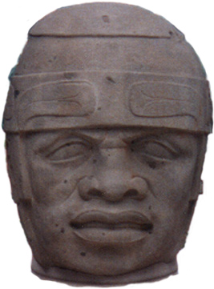
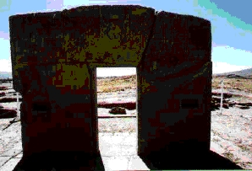
Expanding Networks:
Routes
In the Americas...
The Olmec of Mexico developed extensive trade networks that extended hundreds of miles from Olmec territory. They imported jade and other raw materials for their crafts. Their exports included pottery and sculpture.
The Tiwanakans in what is today Bolivia also began to build trade routes during Big Era Four. Llama caravans brought produce, wood, metals, and fish from outlying villages to the city of Tiwanaku.

Slide 26
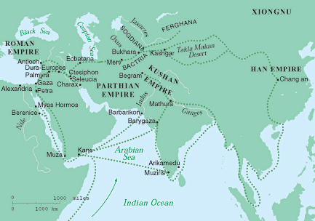
Expanding Networks:
Routes
The silk road, Persian royal road, Roman roads, and shipping routes combined to form extensive interregional networks of exchange in Afroeurasia.
A wide variety of goods flowed along these networks…

Slide 27
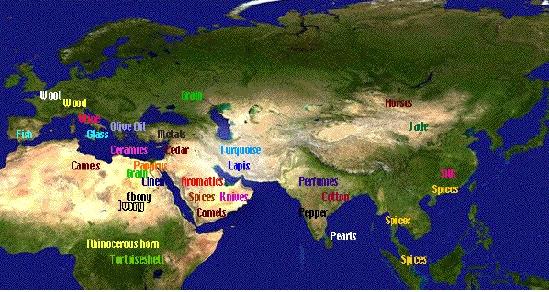
On the map are some of the
goods traded along the
Afroeurasian networks.
Expanding Networks:
Routes

Slide 28
Expanding Networks:
Routes
A number of large states, or empires, appeared in Big Era Four.
Empire-builders had to move troops and supplies, dispatch messages, gather intelligence, and collect taxes.
These tasks required good systems of communication and transport by land and sea.
These systems were created mainly to serve the empire’s government and army.
But they also served as highways of commerce, cultural exchange, and migration.
An empire is a state that unites many territories and diverse peoples under one ruler or government.

Slide 29
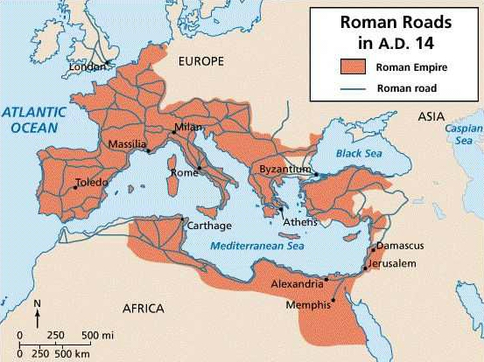
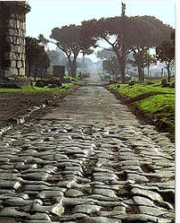
Expanding Networks:
Routes
Roman Roads
The Romans built an extensive network of roads. Over 50,000 miles of paved roads, tracks, and trails radiated from the Forum in the center of Rome to all parts of the empire.

Slide 30
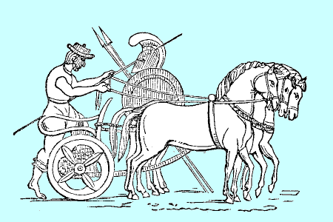
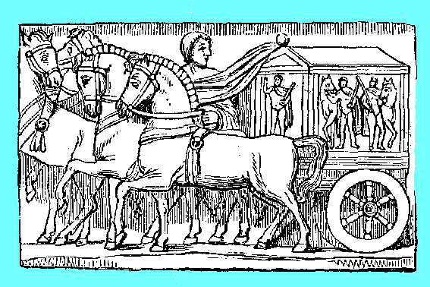
Expanding Networks:
Routes
Though built primarily to speed troops and supplies, Roman roads were used for commercial purposes, too. Goods were shipped to distant provinces and beyond.
Constructed by skilled engineers, the roads were strong enough to support half-ton wagons and wide enough to allow two-way traffic.

Slide 31
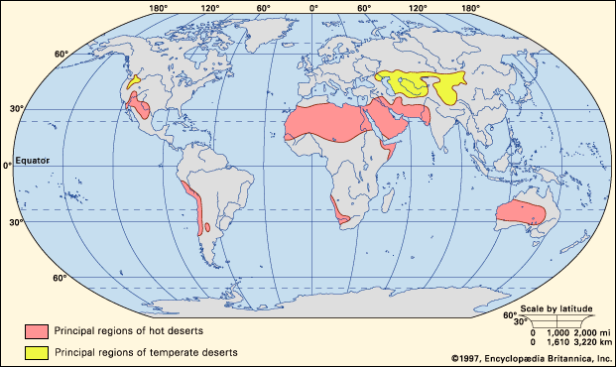
Expanding Networks:
Routes
The Silk Roads was a network of roads, tracks, and trails ran across Inner Eurasia. Most of this region is part of the Great Arid Zone, the belt of dry country that extends
across Afroeurasia.
Inner Eurasia
Great Arid Zone
Notes:
Map: NASA, Earth Observatory, The Blue Marble
http://earthobservatory.nasa.gov/Newsroom/BlueMarble/

Slide 32
Expanding Networks:
Routes
Inner Eurasia is a region of grassy steppes, rugged mountains, and forbidding deserts. This terrain is hard to cross. Despite these harsh conditions, humans have been carrying goods, ideas, and technologies along the Silk Roads of Inner Eurasia for millennia.
I n n e r E u r a s i a
1997, Encyclopedia Britannica Inc

Slide 33
Expanding Networks:
Routes
Domestication of the horse, ox, and camel made humans more mobile.
About 3000 BCE, people in the steppes of Inner Eurasia began to take up pastoralism. Because they moved with their herds, they typically did not grow crops.
Instead, they traded with farmers and city-dwellers for food and other goods.
By 1000 BCE, pastoralists controlled networks of exchange throughout Inner Eurasia .

Slide 34
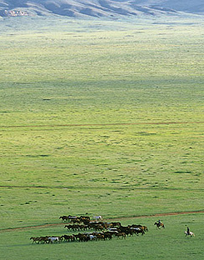
Expanding Networks:
Routes
Between 300 BCE and 300 CE, long periods of stability and prosperity in states throughout Afroeurasia stimulated interest in long distance trade.
Intercontinental communication and the exchange of goods, became regular, organized, and protected by large empires.
The Silk Roads carried shipments of Chinese silk but also many other goods.
Notes:
http://www.kiku.com/electric_samurai/virtual_mongol/index.html

Slide 35
Expanding Networks:
Routes
On the Silk Roads, goods changed hands many times. Parthians, Indians, Kushans, Uigurs, and others acted as middlemen, selling and bartering goods, and taking profits.
Caravans passing west carried silk, porcelain, jade, bronze, and spices.
Those traveling east shipped gold and silver coins, ivory, gemstones, glassware, and carpets.

Slide 36
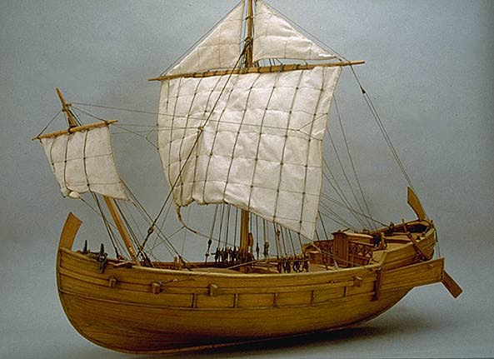
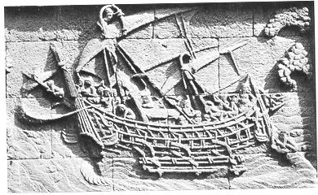

Expanding Networks:
Routes
Roman Ship
Sea routes ran down the Red Sea and Persian Gulf, across the Arabian Sea and Bay of Bengal, and through the Straits of Malacca to the South China Sea.
Indian Ship
These sea lanes often linked up with overland routes, facilitating travel, trade, and the exchange of ideas across Afroeurasia.
Chinese Ship

Slide 37
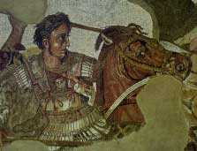
Expanding Networks:
Empires
Empires had formed in Afroeurasia as early as Big Era Three. Although many claimed vast territories, most did not survive for long.
In the 4th century BCE, Alexander the Great amassed an empire that stretched from Greece to India. Upon his death, however, the empire fragmented.
The later centuries of Big Era Four saw the rise of new empires that both dominated huge expanses of land and remained unified for a long time. The
Largest of these were the Han and Roman empires.

Slide 38
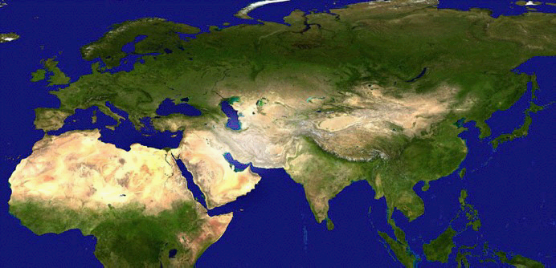
Large Empires of Afroeurasia
500 BCE - 500 CE
Rome
Byzantium
Kushana
Xiongnu
Parthian/
Sassanid
Han
Maurya/
Gupta
Kush
Axum

Slide 39
Expanding Networks:
Writing
Cool!
Alphabetic writing systems appeared in the later second millennium BCE. These systems used a small number of symbols, or letters, to represent sounds.
Letters could be arranged in countless ways to form words.
The Phoenicians were among the first to devise an alphabet.
Because they were sailors and merchants, the idea of alphabetic writing spread wherever the Phoenicians traveled.
During the first millennium BCE alphabetic writing spread from the Mediterranean region to India.

Slide 40

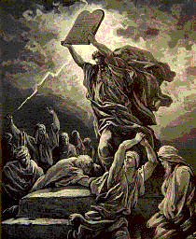
What is a world religion? It’s a belief system that embraces people of differing languages and cultural traditions. Religions that spread during Big Era Four were:
Expanding Networks:
Religions
Hinduism
Judaism
Buddhism
Christianity

Slide 41
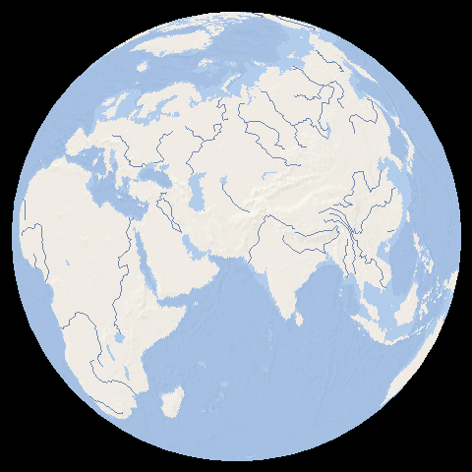
Growth of World
Religions
In Big Era Four
Hinduism
From lst
millennium BCE
Buddhism
From 5th century
BCE
Christianity
From 1st century
CE
Judaism
Communities
scattered widely in
Southwest Asia,
Northern Africa, and
Europe, especially
from the first century
CE.
Outline Map: Microsoft Encarta Reference Library 2002

Slide 42
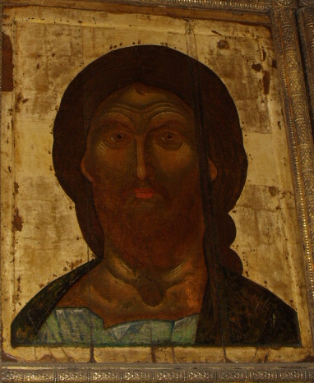
Expanding Networks:
Religions
When people carried a new religion from place to place, they also often took along
A writing system (This was useful in teaching holy scripture.)
Trade goods (Religion was a basis of trust among merchants.)
Art styles (Religious ideas were often expressed in painting, sculpture, and architecture.)
Notes:
Russian Orthodox Icon, Kremlim, Moscow: Photo by Ross Dunn

Slide 43
So, what have we learned about two key developments of this era?
Population growth and networks

Slide 44
Population growth in Big Era Four was linked to the expansion of agriculture. Increases in population density and job specialization in farming communities led to the creation of more and larger cities.
Population Growth
Expanded networks of exchange allowed people, goods, and ideas to move thousands of miles. The development of alphabetic writing systems speeded up the transfer of information. Also, people who met, shared ideas, and conducted business with one another helped spread new world religions across Afroeurasia.
Expanding Networks
of Exchange

Slide 45
So many developments in
Big Era Four!
Hmmm… I wonder what will happen next. Stay tuned for
Big Era Five!

